Slide 1
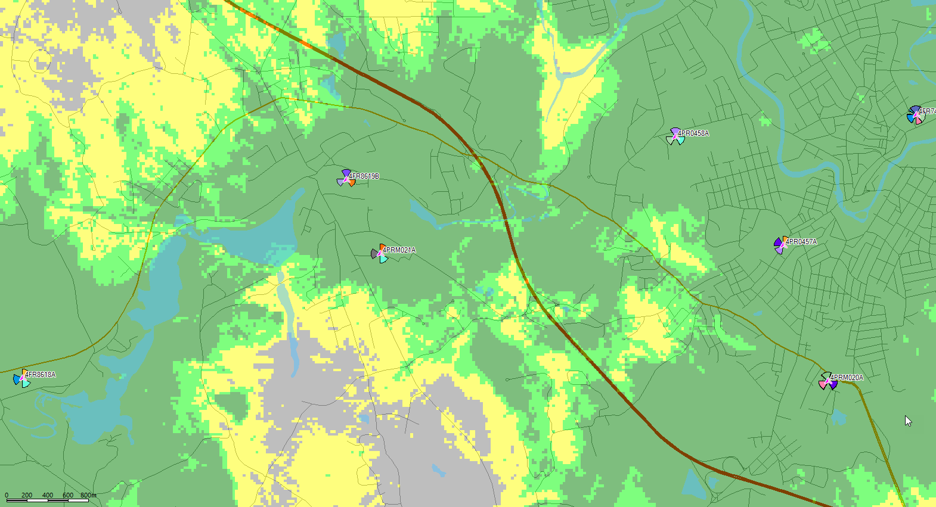
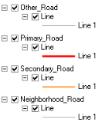
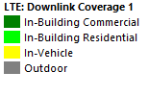
Existing LTE (All Carrier) Coverage – North Smithfield, RI
Existing T-Mobile Site
Map Legend
4PRM021A
Coverage Legend
Notes:
Show only -76dBm and -84dBm coverage levels
Uncovered Pops @ -84dBm within the Target polygon (or use -76dB equal power boundary) must be calculated

Slide 2
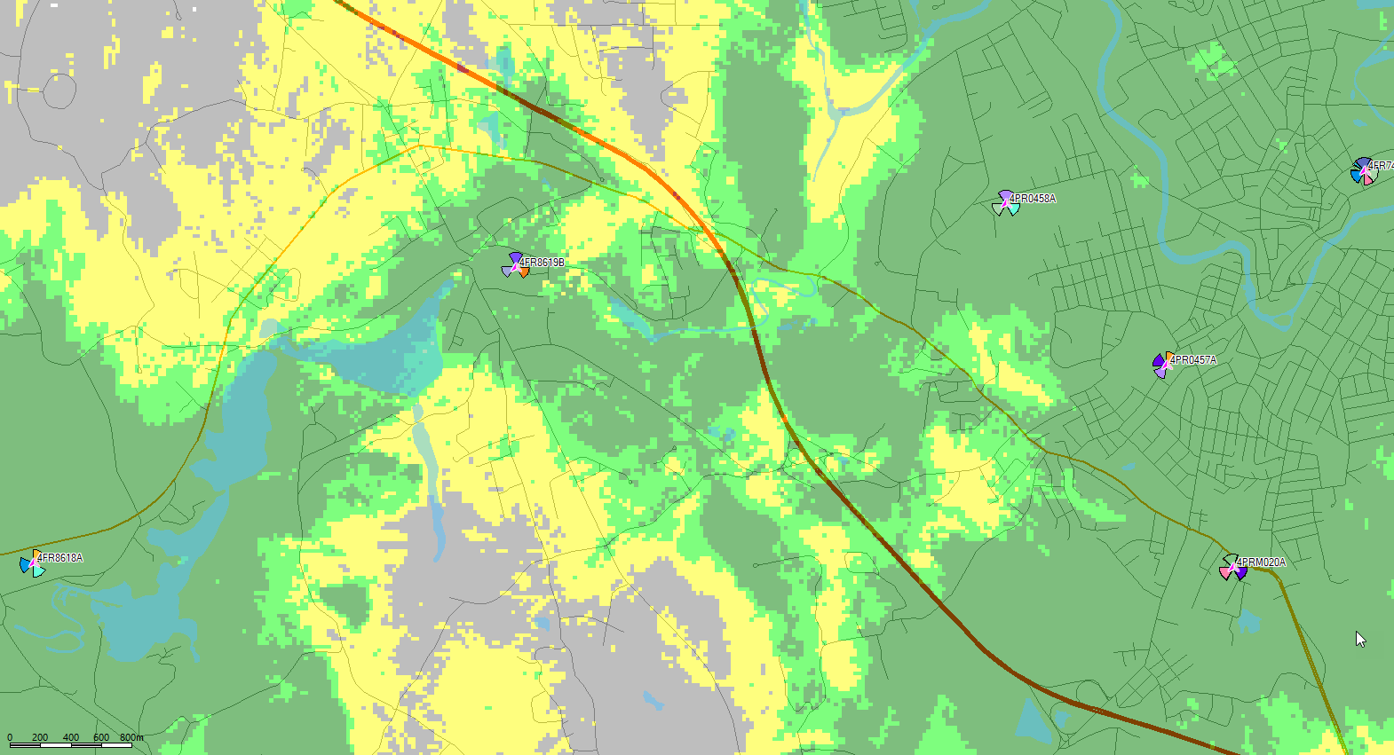
Existing LTE (All Carrier) Coverage without 4PRM021A – North Smithfield, RI
Existing T-Mobile Site
Map Legend
Coverage Legend
Notes:
Show only -76dBm and -84dBm coverage levels
Uncovered Pops @ -84dBm within the Target polygon (or use -76dB equal power boundary) must be calculated

Slide 3
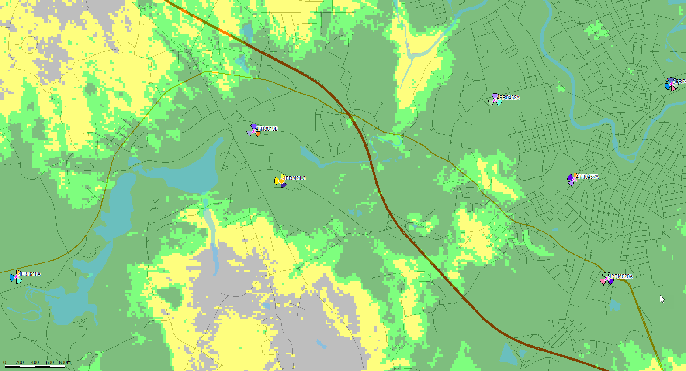
Proposed LTE (All Carrier) Coverage for Replacement site at 119 Feet – North Smithfield, RI
Proposed Monopole
Proposed T-Mobile Site
Map Legend
Site Replacement
Coverage Legend
Notes:
Show only -76dBm and -84dBm coverage levels
Uncovered Pops @ -84dBm within the Target polygon (or use -76dB equal power boundary) must be calculated

